Slide 1
Face Attendance System
By-
N. Divyagnan Reddy (2201130)
V. Pranay Satvik Reddy (2201221)

Slide 2
Objectives:
To minimize human intervention in taking the attendance.
To increase correctness with a proxy free attendance system.
To provide a computationally efficient system that uses queues for delayed processing to satisfy the above objectives.

Slide 3
Methodology:
We are planning to integrate facial recognition in order to reduce human intervention.
The proposed face attendance system aims to automate attendance tracking through live footage, face detection, recognition and anti-spoofing.
System Architecture:
Hardware: Raspberrypi camera modules at the entry of classroom (can be replaced by ESP32 but a trade-off between cost and performace)
Software: Processing pipelines in python, (libraries used: OpenCV, PyTorch , insightface)
Database: Postgresql for storing student's faces (paths), attendace logs, class schedules.
User Interfaces:
Mobile application for students (registration and viewing attendace records)
Mobile application for lecturers to check and modify correction requestion, changes in timetable and class venue
Desktop application for the admin to manage student data, timetables and venue schedules

Slide 4
Data Collection and preprocessing
The data of student's faces are collected from the student registration frontend in an controlled environment to make sure legible photos are captured from all angles.
Images undergo preprocessing using the retinaface which outputs detected faces, five points landmarks, this is used for precise alignment to output images in standard 112*112 image format and these images are augmented to generate variation and more images in the dataset.
The extracted images are stored in folders with names of corresponding students

Slide 5
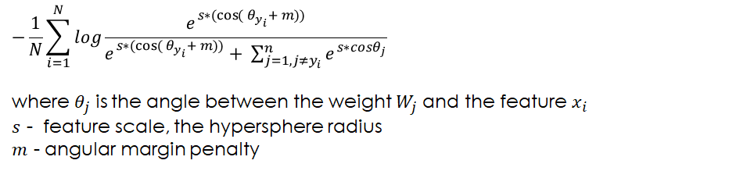
Model Maker
Architecture:
Resnet100 backbone pretrained using arcface loss.
Loss function:
Finetuning the model by adding a fully connected layer after the 512 embedding output layer with the number of classes (students) as the new output layer, this allows classification of images and this is trained with the same loss function for 30 epochs.

Slide 6
Model
The output of the model maker
The classifier uses normalized feature embeddings (512-dimensional) with cosine similarity for predictions.
Training employs differential learning rates (lower for backbone, higher for classifier) using AdamW optimizer.
The model measures performance using accuracy, precision, recall, and F1 score metrics.
It's designed to handle various facial imaging conditions (lighting, occlusion, poses) through targeted augmentations.

Slide 7
Test results
TEST Results:
Loss: 0.0293, Accuracy: 1.0000
Classification Report:
precision recall f1-score support
divyagnan 1.00 1.00 1.00 8
hemanth 1.00 1.00 1.00 5
jignesh 1.00 1.00 1.00 6
satvik 1.00 1.00 1.00 6
accuracy 1.00 25
macro avg 1.00 1.00 1.00 25
weighted avg 1.00 1.00 1.00 25
Test Results:
Loss: 0.0293 | Acc: 1.0000
Precision: 1.0000 | Recall: 1.0000 | F1: 1.0000

Slide 8
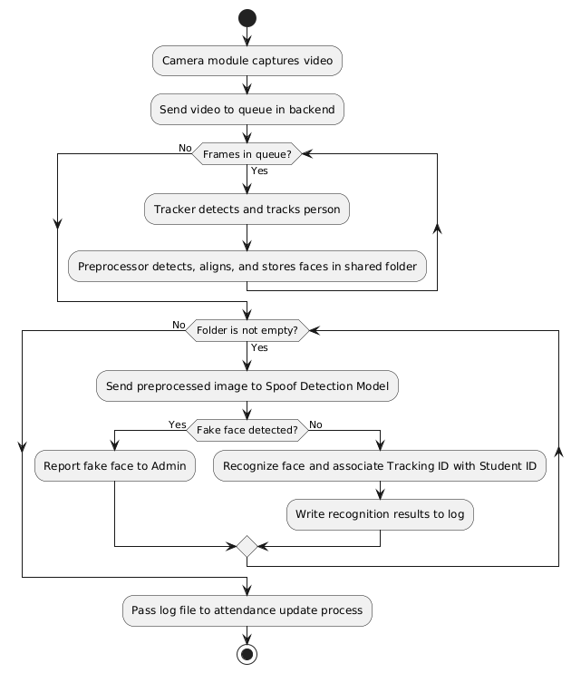
Face recognition pipeline

Slide 9
Spoof detection (Yet to experiment and implement)
Experimenting with TATT and FAS-Transformer for video-based spoof detection using temporal modeling.
Testing CDCN++ and MMDR, which utilize RGB, depth, and IR data for improved anti-spoofing accuracy.
Evaluating AASIST and SSAN for cross-dataset generalization and robustness against unseen spoofing attacks.
Exploring FeatherNet and DeepPixBiS for efficient and real-time spoof detection on edge devices.
Assessing STASN and STDN for integrating both spatial and temporal cues in spoof detection.
Planning to fine-tune YOLO models on CelebA-Spoof and CASIA-SURF datasets to detect printed and digital spoof attacks.

Slide 10
Problems and plausible solutions
Bottleneck in Model Architecture:
Issue: When the number of classes increases (e.g., 1000), the direct connection from the embedding layer (512-d) to the output layer creates a diffusive and inefficient mapping.
Solution:
Introduce intermediate hidden layers using a formulated approach to optimize layer connectivity and mitigate bottlenecks.
Develop separate models for different sections of students, storing their weights independently to improve classification accuracy.
Scalability Constraints
Issue: The current model architecture requires full retraining when new students are added, limiting scalability.
Solution:
Since our institution has a fixed yearly intake, periodic retraining (e.g., once per year) is a feasible and efficient strategy.
Explore incremental learning techniques to update the model without full retraining, enhancing adaptability to new enrollments.

Slide 11
Task progress
The model maker (complete)
Data preprocessor and tracker (complete)
Data collection through the front end (partial)
Spoof detection (yet to complete)
All pipelines need to be tested.

